Slide 1
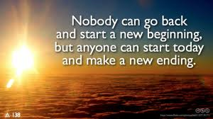
Duchenne Parent Project.NL /PPMD . USA

Slide 2
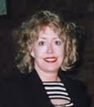
Orlando, Florida 1994

Slide 3
Basic Principles:
As parents we could do something
We could raise money
We could support research and rigorous review
As parents we would do whatever it takes
We would look leave no stone unturned
We would work together
We would smile again

Slide 4
Our Strategy
Fund Opportunistic Research
Engage the Community
Encourage Robust Advocacy
Demand Integrated Education and Care

Slide 5
Why are we here?
An ecosystem is a community of living organisms (plants, animals and microbes) in conjunction with the nonliving components of their environment (things like air, water and mineral soil), interacting as a system. These components are regarded as linked together through nutrient cycles and energy flows
A drug development ecosystem is a community of stakeholders (universities, companies, patient organizations, patients, government organizations) in conjunction with the nonliving components of their environment (things like regulations, economic factors, reimbursement potential), interacting as a system. These components are regarded as linked together through clinical research cycles and funding flows
Companies
Economy
Government
Regulations
Paitents
Patient
Organizations
Reimbursement
Universities

Slide 6
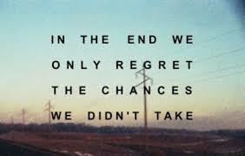

Slide 7
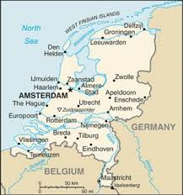
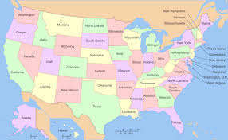
Different Countries/Different Opportunities
Carving our own Path
Understanding opportunities and challenges
How hard is fundraising/differences between countries

Slide 8
First Steps Together
Non-profit -USA/NL
Scientific Advisory Board
Early support
U. Pittsburgh DMD RC
Judith vanDeutekom
U. Buffalo -screening

Slide 10
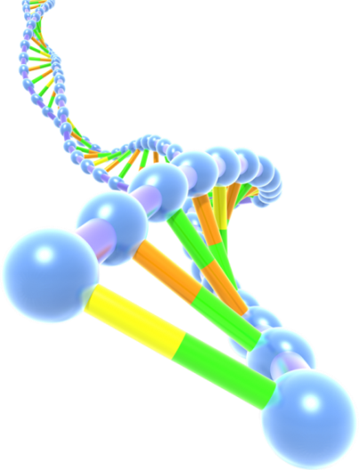
A Parent’s Cycle
Upon discovery, parents rush to find information and hope.
They eventually find the right agencies to partner with.
As a result they find the right resources.
They begin to implement the correct regimes.
They are now the local experts.
They work to change the cycle.
Networks
Google/FB
Schools and friends
Treatment Regimes
Hospitals and Universities
Agencies
Advocacy

Slide 11
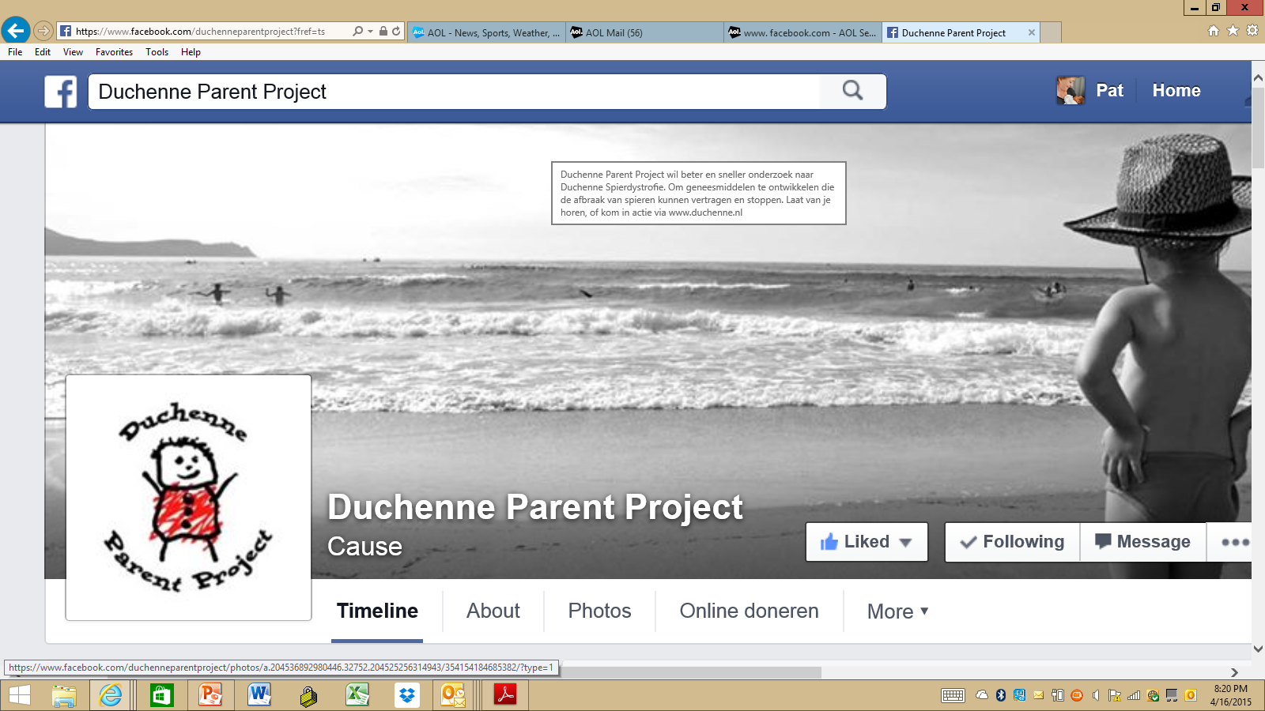

Slide 12
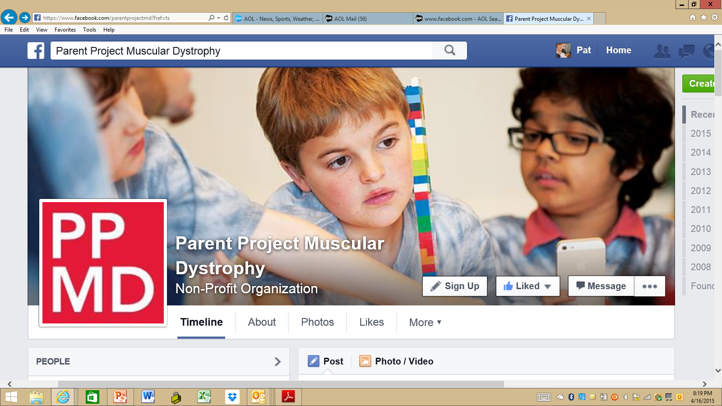

Slide 13
Evolving models
DPP.nl
Investing in research
Standards of Care
Incentivizing companies
Outcome measures
EMA (regulatory agenda)
First Conditional Approval
PPMD. USA
Legislation –MD CARE Act
NIH/DOD
CDC Care Considerations
Duchenne Connect Registry Investing in Research
Drug Development Roundtable
FDA

Slide 14
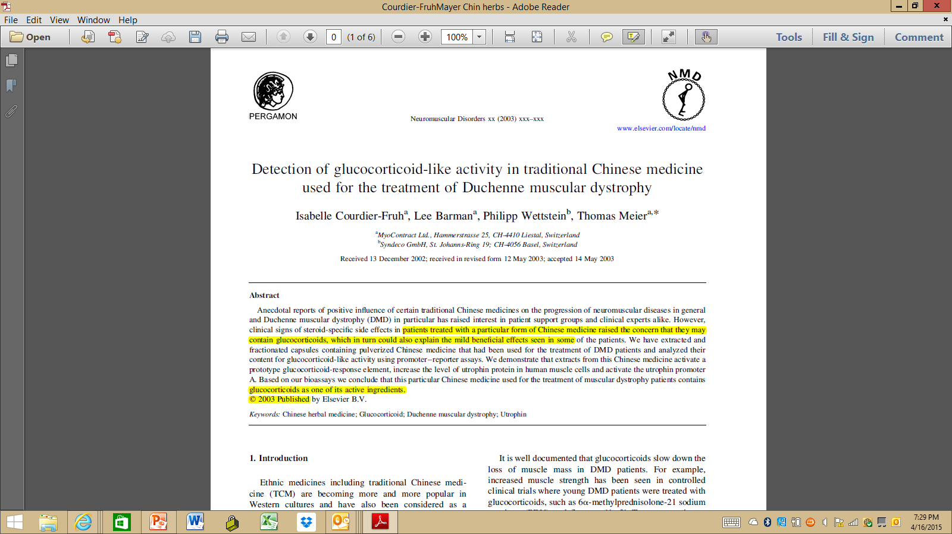

Slide 15
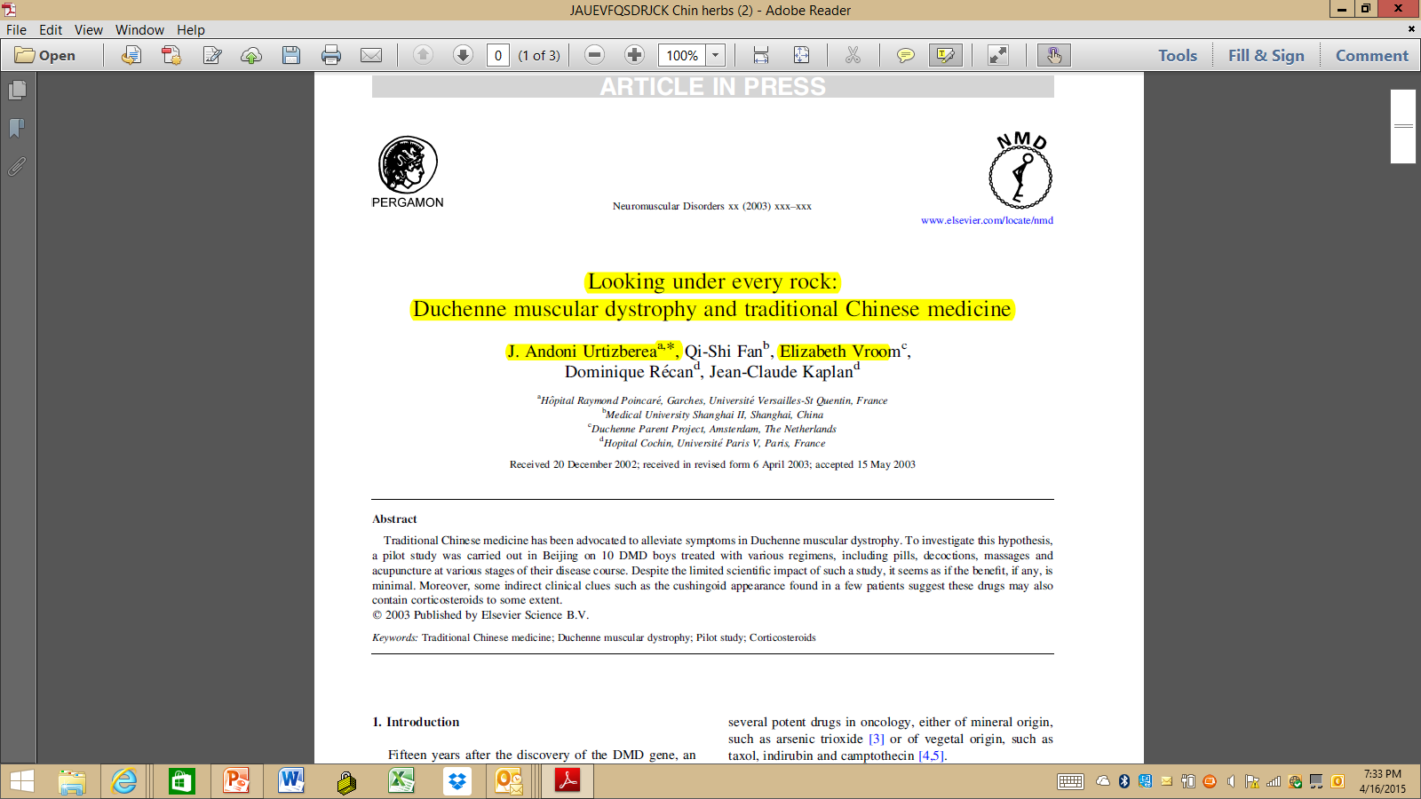

Slide 16
The Voice of the Patient (Family member)
.......It is important that the needs of patients are the starting point for initiatives concerning them. There is a lot to win if their experience and expertise is utilized these. People with disabilities and diseases know what it means to have this condition. It means they will bring in a different perspective to caregivers, physicians, researchers or policymakers. Their questions and needs are based on their own experiences, interests and vision.

Slide 17
Stop-codon Readthrough
Exon-Skipping
Gene Therapy
Functional replacement with other proteins
Dystrophin Restoration/Replacement
Anti-fibrotics
Inflammation & Fibrosis
Poloxymer
Treating Duchenne
Cardiac
Serca 2A
Steroid Replacements
Calcium Regulators
Traditional cardiac drugs
Muscle Mass
Blood Flow
Ryanodine Receptor
Muscle growth pathways
Stem Cells
PDE5

Slide 18
What does this mean to us?
PATIENT VOICE IS INMPORTANT
POLICY
GOVERNMENT
INDUSTRY
An organized patient voice is necessary and important for regulatory change.

Slide 19
Engagement with FDA
Meetings with Division of Neurology (2012-ongoing)
Duchenne Policy Forum (December 2013)
19 FDA officials in attendance
Dr. Janet Woodcock, Director of the Center for Drug Evaluation and Research, “We share your goal of getting disease-modifying therapies onto the market as rapidly as possible”
Agreement with agency that the Duchenne community would create draft guidance on Duchenne for consideration
Notes:
These recommendations have been raised in meetings with the agency as we have been engaging with the neurology division over time. To date we have held several meetings with Janet Woodcock and others and all these interactions culminated in a duchenne policy forum which was held in December of last year. Dr. Woodcock opened the meeting expressing the agencies desire to get disease modifying therapies to patients as quickly as possible. We are going to continue to put pressure on the agency to live up to those words.
The forum closed with an agreement with the agency that the duchenne community would create a draft guidance for their consideration.

Slide 20
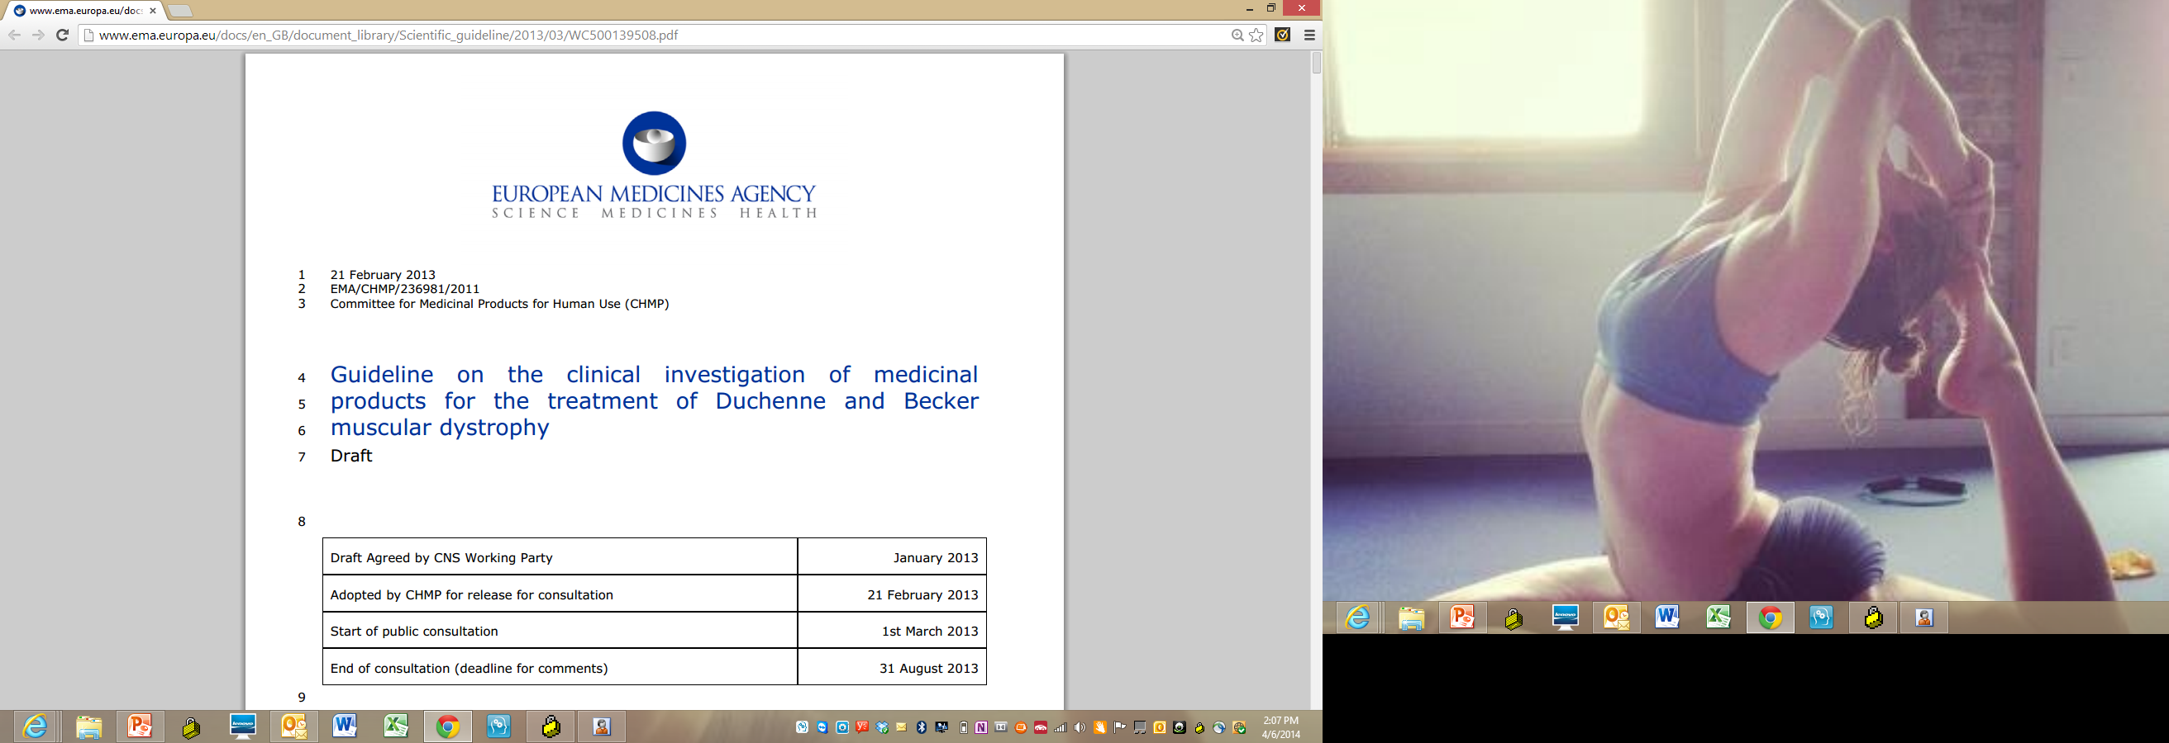

Slide 21
Draft Guidance on Duchenne
Draft Guidance on Duchenne
Draft guidance promised by May 2014
Community engagement throughout process
Structure
Steering Committee
Working groups
Community Advisory Panel
Notes:
This obviously brings us to why we are here today. We made a commitment as a community produce this guidance by May. Our desire, as always is to incorporate the full breath of knowledge of the voice of the patient and caregiver into the draft guidance. In a minute you will hear from Craig about the progress to date and the plan moving forward.
It is our commitment to incorporate the full breath of knowledge of the voice of the patient and caregiver into the draft guidance.

Slide 22
Importance of Draft guidance
Potential impact on all future submissions and reviews of Duchenne candidate treatments
Contribute patient/parent insight and data to FDA deliberations
A means of concrete, sustaining progress
Being viewed as a model/precedential by other groups (rare diseases)- shaping the future

Slide 23
Imperatives Working Group –OUR VOICE
There is a need for open access to natural history databases for aggregation and meta-analyses, in order to better define effect sizes of potential sources of heterogeneity in outcome, and better characterize the natural history of the disease.
Clinical trial, outcome measures and considerations
The Duchenne Community want trials that are inclusive of people with Duchenne of all ages across the spectrum of disease.
There is widespread support in the community to move away from placebo-controls or to use trial designs that minimize exposure to placebo. It is hard for patients and families to accept being placed on placebo, knowing that every day, a child with DMD loses muscle cells and functions.
Sponsors are requested to address the co-morbid conditions of Duchenne, such as heart disease, which may become exacerbated if new therapies do help prolong life and function.

Slide 24
While post-hoc analyses are generally not of accepted by the FDA as supporting an NDA, we would ask the FDA to use flexibility in the case of rare diseases.. The limitation of natural history, and development of novel endpoints will naturally lead to post-hoc statistical analyses based upon emerging concepts of natural history. This is a moving target. Regulatory agencies should exhibit some flexibility with regard to post-hoc analyses, otherwise, the field will be littered with ‘failed’ drugs, which have not actually failed, but were merely tested in the wrong population, or using the wrong endpoints, because of the limited knowledge about the disease.
Access to individual data: Companies should pre-specify whether or not a family will be given access to their individual data.
Compassionate use, extension studies and informed consent: We recognize that sponsor’s ability to offer continued treatment after a study has concluded may be limited by the lack of adequate preclinical safety data — or clear safety and efficacy concerns about the compound. However, it may be in a sponsor’s best interest to consider an extension phase, given that researchers are still learning how to measure benefit in these populations — and a longer course of study may be needed to tease out how the drug might be efficacious and in which population

Slide 25
Regardless, the sponsor has an obligation to clearly explain its intentions to the community and the community has an obligation to understand what are the limitations of the sponsor’s ability to offer an extension phase of a trial.
The informed consent should specifically spell out:
Whether the company has a policy on pre-approval compassionate use (and/or plans for expanded access programs), and
What that policy is; and
What the expectation is about expanding into an extension phase of the study after a trial is done and if there are positive results.
Also, regarding compassionate use, when a family has more than one child with DMD, and one child is included in the study, we would urge sponsors to make a plan to offer the treatment as well to the other child who may not fit the study’s inclusion criteria on a compassionate use basis, as soon as safety has been established. Having one child able to access an experimental treatment, and the other not, can be a source of great distress in a family.

Slide 26
Sponsors should also be aware that participation in clinical trials can be a burden for the patient and his family — particularly in older non-ambulatory boys with limited mobility. Making trials more patient- and family friendly — with appointments on weekends or after-work hours and other services to help working parents — could increase accrual in studies.
Conducting a trial, or parts of a trial closer to home to minimize burden on family could also encourage enrollment. While there may be limitations as to where children can be dosed and where standardized outcomes can be assessed, one approach has been to have safety assessments done locally while outcome assessments are performed at specialized centers.

Slide 27
How DPP and PPMD Engage the Pipeline
Corporate engagement program
PPMD newsletter/blogs/webinars
Clinical trial support
Input to FDA/EMA
Conference & Policy forums
ENMC meetings
UPPMD
Engaging in discussion around post marketing data
ACCESS/REIMBURSEMENT
****Combo Therapies program
Exploratory/bridge grants
Duchenne Connect Registry
NBS effort
Care consideration guidelines
Replication studies
Trial
Readiness/
Phase 1
Phase 2/3
Regulatory
Approval
Post-
Market
Discovery & Preclinical
MD STARnet
PPMD Certified Duchenne Care Centers
Federal agency partnering (e.g., MDCC, NHLBI)
TREAT-NMD TACT support
PPMD/C-Path Duchenne Regulatory Science Consortium
Duchenne Drug Development Roundtable
Biomarker/Nat Hist funding
Duchenne draft guidance
Benefit-Risk Survey
Putting Patients First white paper
Support for Conditional Approval/ accelerated approval
Slide adapted from CTTI

Slide 28
Patient Focused Drug (and DEVICE) Development
Advance research
Improve, facilitate recruitment for clinical trials
Deliver therapies
Deliver Robotics
Make a difference for thousands of young men around the world
The promise of a full life.

Slide 29
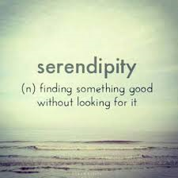

Slide 30
Last thought
The world breaks everyone and afterward many (ALL of us) are strong(er) in the broken places
Ernest Hemingway (1899-1961)
THANK YOU – for 20 years of progress. Pat Furlong/PPMD

