Slide 1
Overview of non invasive biomarkers
Pietro Spitali
Human Genetics - LUMC
DELFT, 16th April 2016

Slide 2
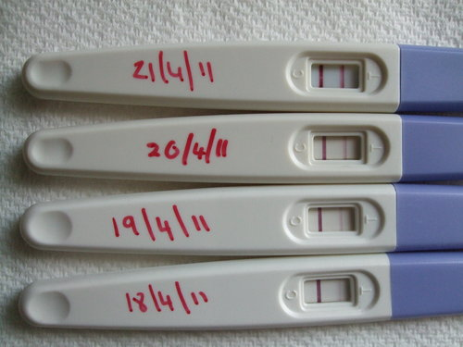
What is a biomarker?
“a characteristic that is objectively measured and evaluated as an indicator of normal biological processes, pathogenic processes, or pharmacologic response to a therapeutic intervention”
human chorionic gonadotropin

Slide 3
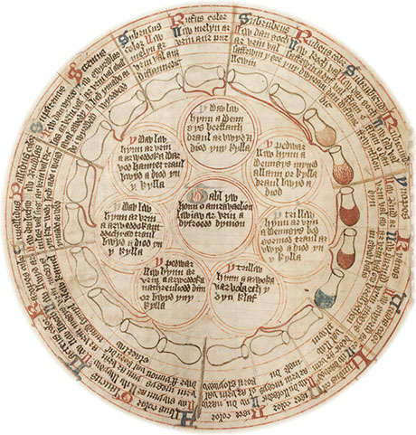
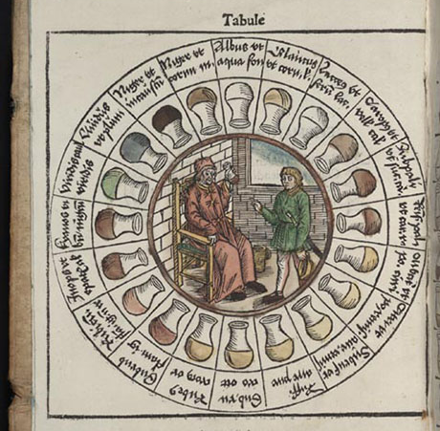
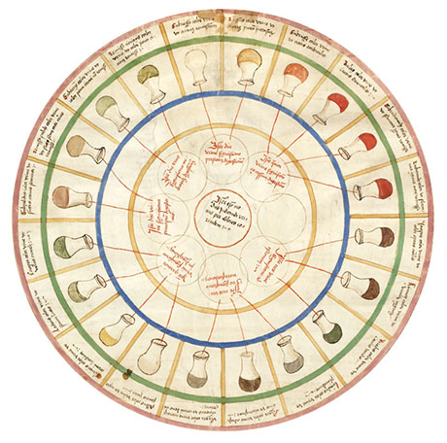
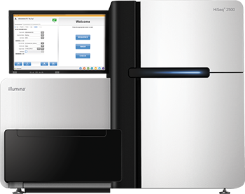
Old concept → New applications
Urine tasting to detect diabetes (urine wheels)
Blood pressure as risk for stroke
Cholesterol levels for coronary and vascular disease
Serum CK levels for muscle damage

Slide 4
Different types of biomarkers
Diagnostic -identify what is wrong
Prognostic -predict disease development
-separate fast evolving to slow evolving cases
Monitor Therapy -identify who to enroll (responders vs non responders)
-phramacodynamic
monitor whether drug is affecting target
monitor systemic effects of the drug
-Surrogate endpoints
anticipate changes in clinical performance
monitor side effects
Support and accelerate drug approval

Slide 5
More Invasive and Less Invasive
Muscle biopsy Invasive
Direct information on muscle condition
Does not represent all body muscle
Blood test Less Invasive
Represents whole body (all muscles)
Indirect information on muscles
Saliva/Urine Less Invasive
Partial representation of body
Indirect information on muscles

Slide 6
Why do we need biomarkers?
Objectively evaluate patients condition
Reduce variability of clinical tests
Improve patients management
Accelerate drug approval

Slide 7
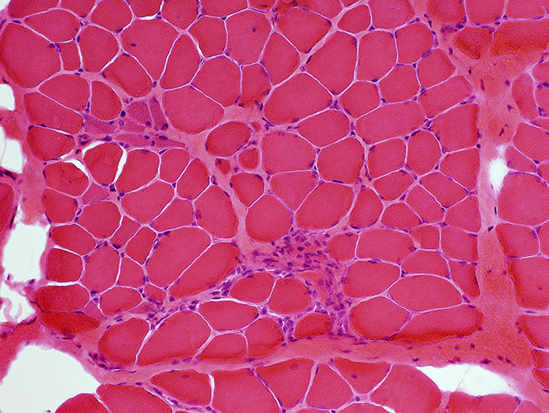
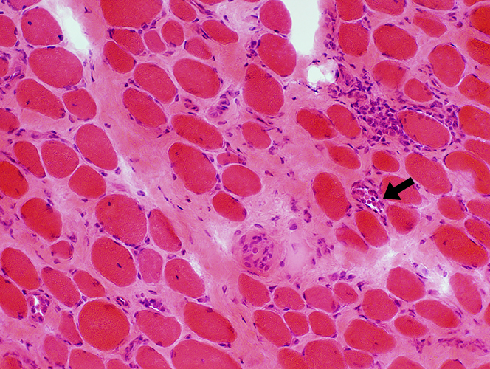
Example 1: diagnostic (invasive and non invasive)
Normal between 60 and 180 U/L
Healthy control toddler DMD 10 years DMD

Slide 8
Example 1 continued..
Example of diagnostic biomarkers
We have them already!

Slide 9
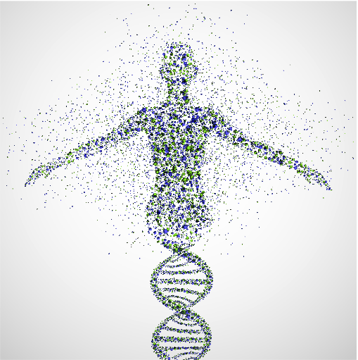
Example 2: prognostic - non invasive
Genetic modifiers
Differences in DNA present in the healthy control population that have an impact on disease progression in patients.
Example:
-2 brothers with DMD
-They share the same mutation
-They share the same environment
-They have very similar but not identical genetic information
-1 is doing better than the other
-what is the cause?

Slide 10
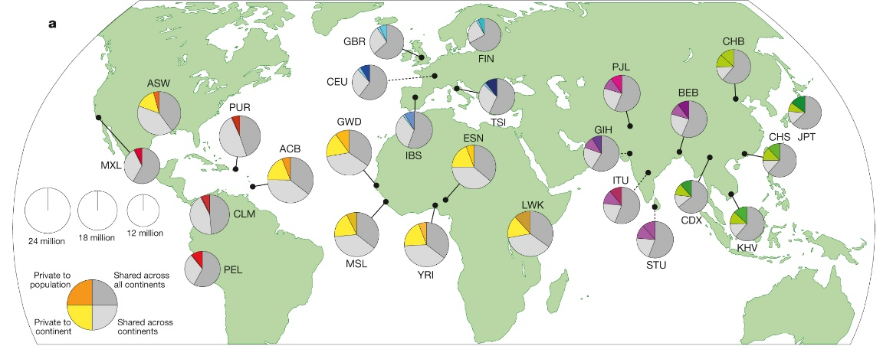
Differences in genetic variation across the world
 | Africa | Americas | East Asia | Europe | South Asia
Samples | 661 | 347 | 504 | 503 | 489
Million Variants | 4.31 | 3.64 | 3.55 | 3.53 | 3.6
A Auton et al. Nature 526, 68-74 (2015) doi:10.1038/nature15393

Slide 11
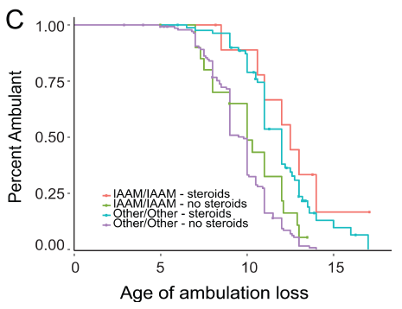
What are the relevant genetic modifiers for Duchenne patients
These are not mutations
Present in healthy control population
Contribute to differences among individuals
This is not completed
Ongoing research effort

Slide 12
Example 3: monitor function - non invasive
Blood
Urine
Identify associations
Individual
Clinical exam

Slide 13
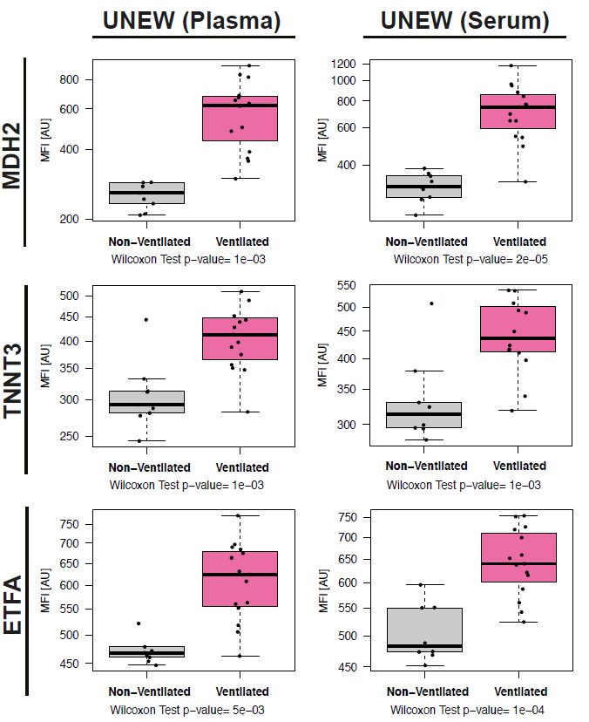
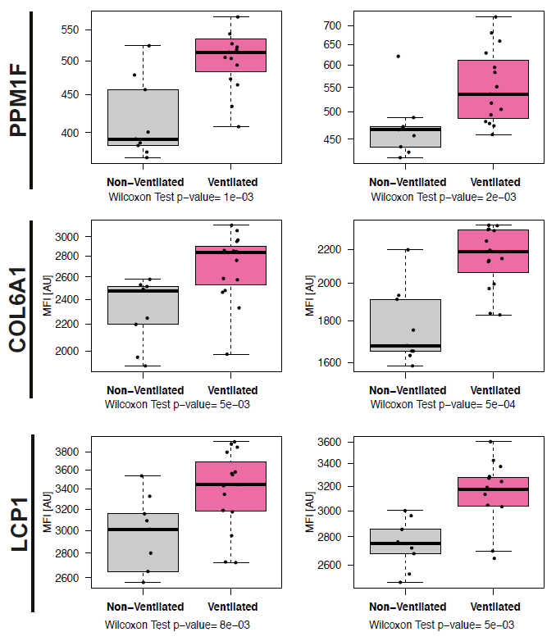
Ventilation support is reflected in serum

Slide 14
Many groups studying biomarkers in DMD
Extensite collaboration in the field
Research funded by charities such as DPP and AFM but also EU
Validation of each other results is very important

Slide 15
Acknowledgments
Human Genetics, LUMC CPM, LUMC
Monika Hiller Tiziana Pacchiarotta
Kristina Hettne Oleg Mayboroda
Peter-Bram ‘t Hoen
Annemieke Aartsma-Rus Neurology, Newcastle, UK
Hanns Lochmuller
Neurology, LUMC
Janneke van den Bergen Neurology, UCL, London
Zaida Koeks Francesco Muntoni
Jan Verschuuren
Erik Niks KTH, Stockholm, Sweden
Cristina Al-khalili Szigyarto
Medical Statistics, LUMC
Stefan Bohringer Profilomic
Roula Tsonaka Alexandre Seyer

Slide 16
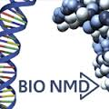
Sponsors

