Slide 1
Results Questionnaire
DMD Early diagnosis
January-February 2016

Slide 2
Responded countries
Argentina
Australia (2x)
Belgium
Cyprus
Czech republic
Denmark (2x)
France
Germany
Greece
India
Kenya
Mexico (2x)
Netherlands
Romania
Spain (2x)
Switzerland (2x)
Syria
United Kingdom(2x)
USA

Slide 3
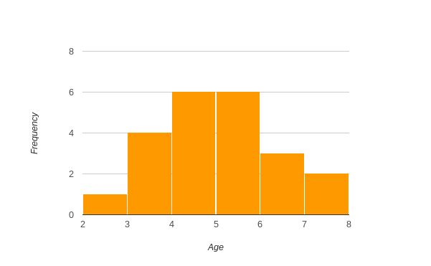
What is the average age DMD children are diagnosed in your country?
the Netherlands: 4,5 years

Slide 4
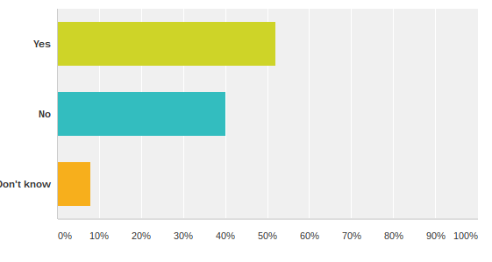
Do you have a program in your country where all young children undergo medical and developmental tests on a regular basis?
52% Yes (the Netherlands)
40% No
8% Don’t know

Slide 5
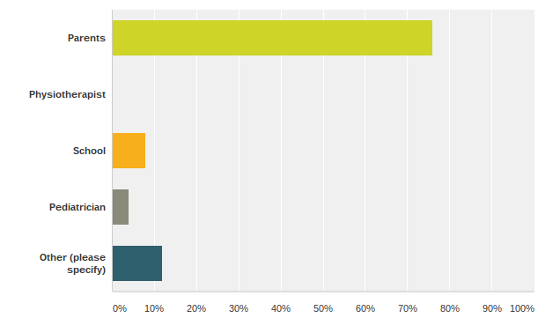
What is the most heard first person to discover something is wrong?
0% Pysiotherapist
4% Pediatrician
8% School
76% Parents (the Netherlands)
12% Other:
Very different
Parents and School (inc Nursery School from age of 2).
Of course parents/family know first.
Patient are not visited until after a problem has been detected.
Sometimes it is a teacher pointing out a delay.

Slide 6
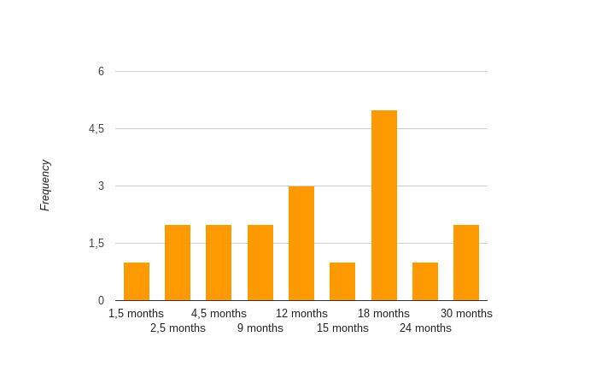
How long does it, on average, take between the first concerns and the diagnosis?
the Netherlands: 15 months

Slide 7
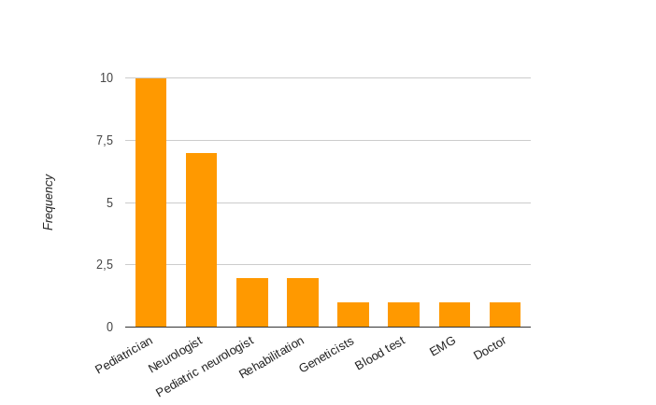
Who typically makes the diagnosis?
the Netherlands: Pedriatric neurologist

Slide 8
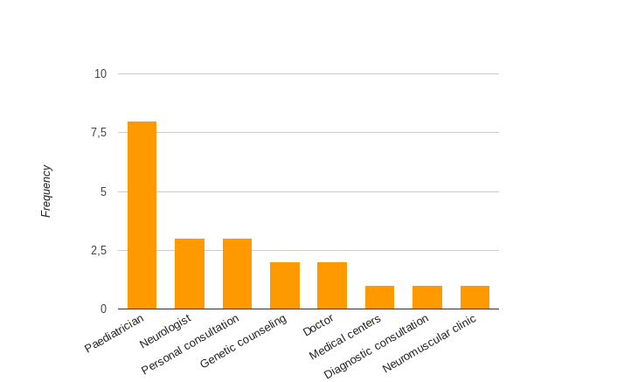
How do parents receive the information about the diagnosis?
the Netherlands: Personal consultation

Slide 9
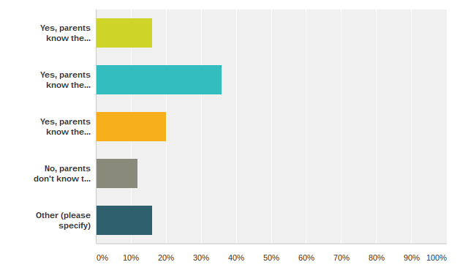
Do parents know the mutation of their son? Do they receive a written confirmation? Do parents receive a 'family letter' to inform family members about the risk of being carrier?
36%: Yes, parents know the mutation, receive a written confirmation but they don't receive a 'family letter'
20%: Yes, parents know the mutation but don't receive a written confirmation. They don't receive a 'family letter.
16%: Yes, parents know the mutation, receive a written confirmation and a 'family letter'
the Netherlands: Yes, parents know the mutation, receive a written confirmation and half of the parents receive a family letter.
12%: No, parents don't know the mutation. They don' t receive a written confirmation and 'family letter'
16%: Other:
This is also very different, there's no common procedure.
Typically all the above can apply as the process varies from area to area. Also some parents can be confused by the information and not fully understand.

Slide 10
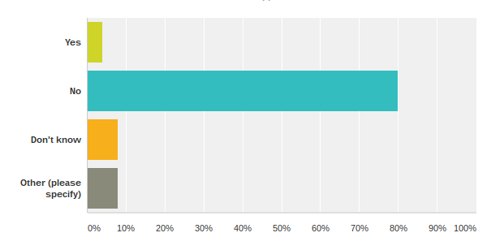
Is there a NBS (new born screening) program for DMD in place in your country?
80% No (the Netherlands)
8% Don’t know
4% Yes
8% Other:
In some clinics they have it, but most of the clinics do not screen new born babies.
No, only in families that already have a child with DMD.

Slide 11
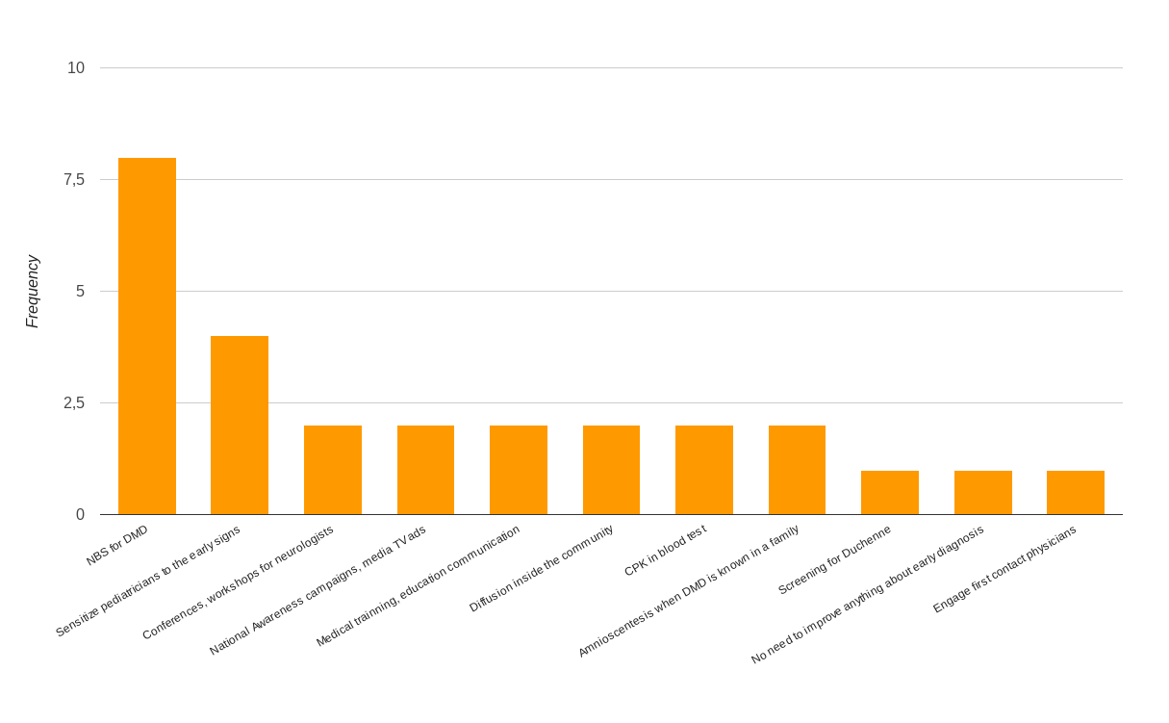
What would you suggest to improve early diagnosis in your country?
the Netherlands:
NBS for DMD

